Slide 1
C MINI PROJECT
GO FOODS

Slide 2
TEAM MEMBERS
Ananya - PES2UG21CS066
Ankitha K – PES2UG21CS078
Akshata- PES2UG21CS050

Slide 3
INTRODUCTION
Introduction:
This project is aimed at food ordering/delivery system. The purpose of the project is digitalized food ordering which is user friendly, simple, fast and cost effective. Anything you want from the comfort of your home.

Slide 4
ABSTRACT
LOGIN/SIGN UP
FOOD CHOICES
ORDER AND BILLING

Slide 5
CODE SNIPPETS

Slide 6
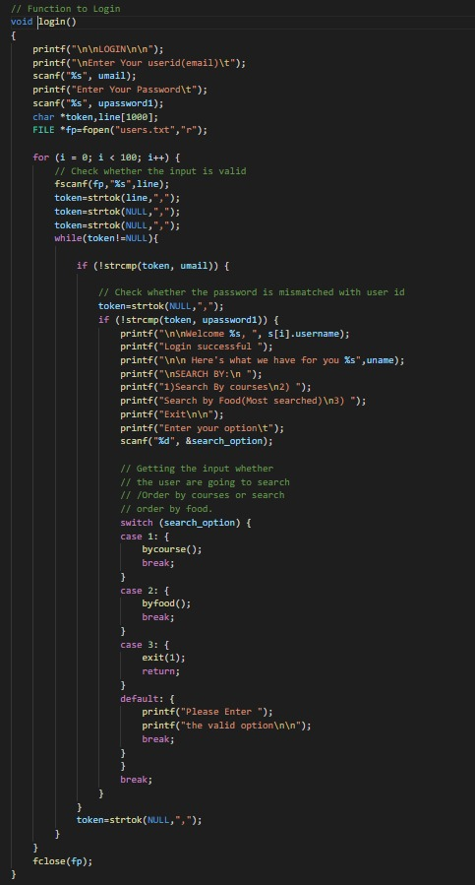
LOGIN/SIGNUP

Slide 7
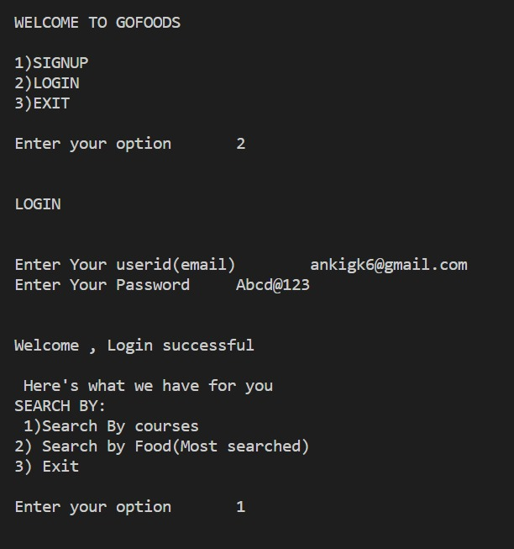
OUTPUT

Slide 8
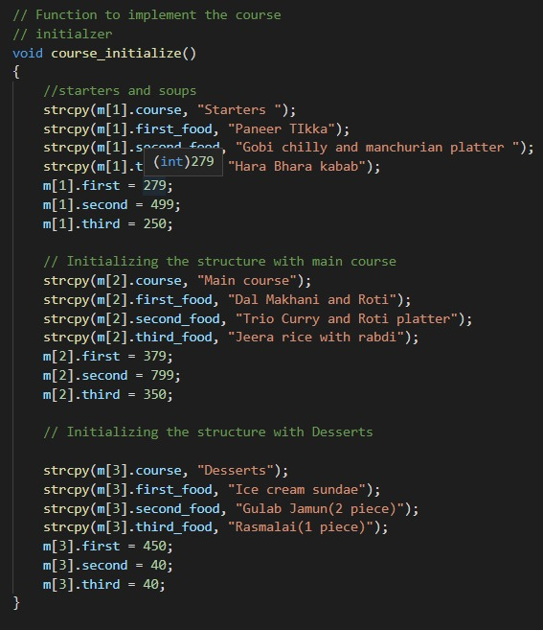
MENU:

Slide 9
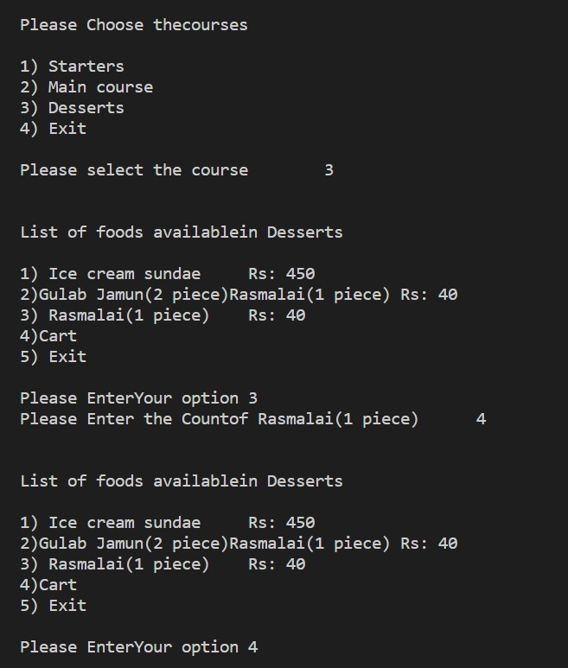
OUTPUT

Slide 10
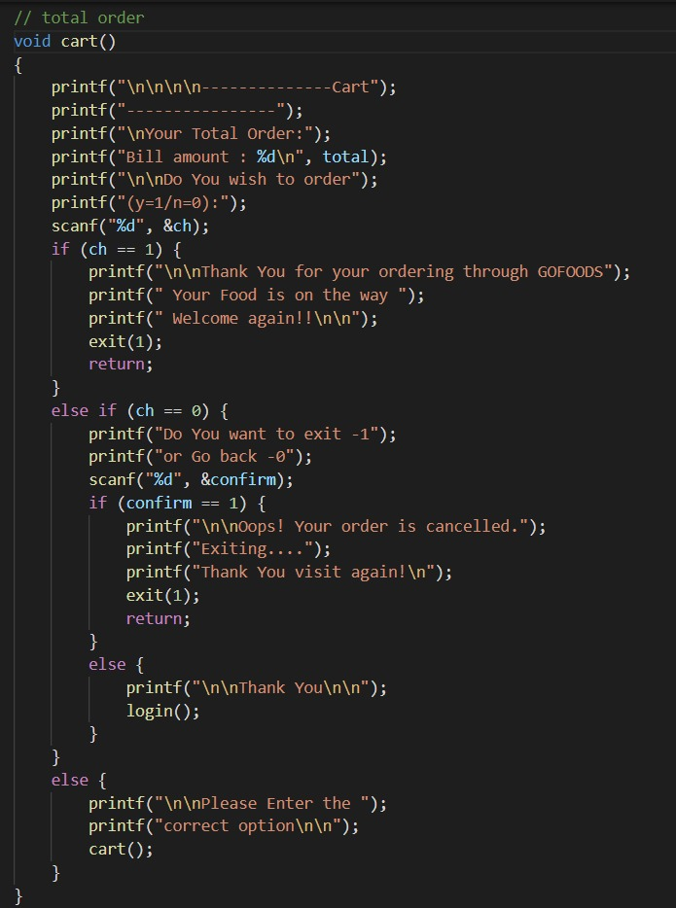
BILLING SYSTEM

Slide 11
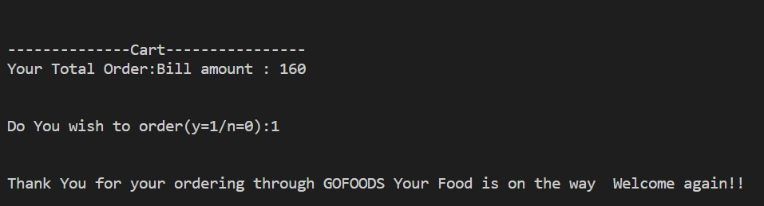
OUTPUT:

Slide 12
Division of work:
ANANYA | ANKITHA | AKSHATA
LOGIN/SIGNUP PASSWORD VALIDATION | CATEGORIES OF ORDERING MENU | ADD TO CART BILLING EXIT

Slide 13
FUTURE SCOPE
Adding GUI and making the project more user-friendly.
Email and messaging the bill and tracking order.
Expanding menu considering the user’s choice.
Feedback and rating system.

Slide 14
THANK YOU

